Slide 1
Synchronous Counters

Slide 2
Lecture Overview
Counting is frequently required in digital computers and other digital systems to record the number of events occurring in a specified interval of time.
Normally an electronic counter is used for counting the number of pulses coming at the input line in a specified time period.
The counter must possess memory since it has to remember its past states. As with other sequential logic circuits counters can be synchronous or asynchronous.

Slide 3
Classifications of Counters
Asynchronous Counters
  Only the first flip-flop is clocked by an external clock. All subsequent flip-flops are clocked by the output of the preceding flip-flop.
  Asynchronous counters are slower than synchronous counters because of the delay in the transmission of the pulses from flip-flop to flip-flop.
  Asynchronous counters are also called ripple-counters because of the way the clock pulse ripples it way through the flip-flops.
Synchronous Counters
  All flip-flops are simultaneously clocked by an external clock.
  Synchronous counters are faster than asynchronous counters because of the simultaneous clocking.
  Synchronous counters are an example of a state machines design.

Slide 4
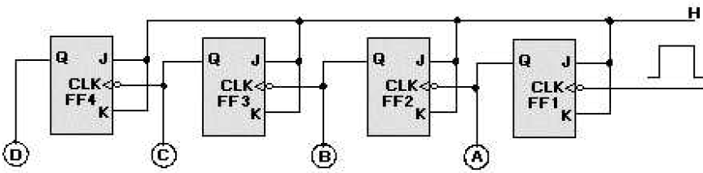
Modulus-8 Asynch/Ripple Counter
Ripple counters work like a chain reaction that ripples through the counter because of the time involved.
Figure shows a basic four-stage, or modulo-16, ripple counter.
The inputs and outputs are shown in next figure.
The four J-K flip-flops are connected to perform a toggle function; which divides the input by 2.
The HIGHs on the J and K inputs enable the flip-flops to toggle.
The inverters on the clock inputs indicate that the flip-flops change state on the negative-going pulse.
The ripple counter is also called an ASYNCHRONOUS counter

Slide 5
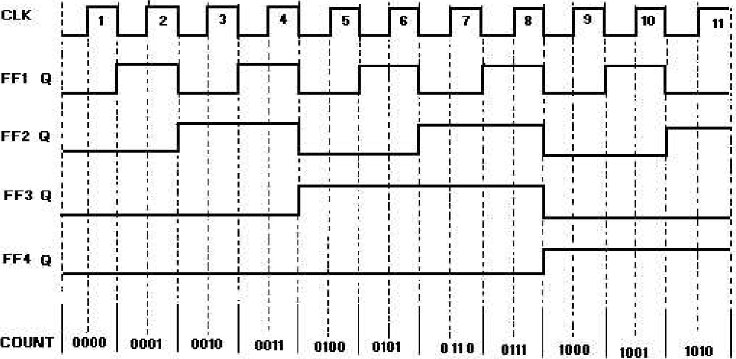
Modulus-8 Asynch/Ripple Counter

Slide 6
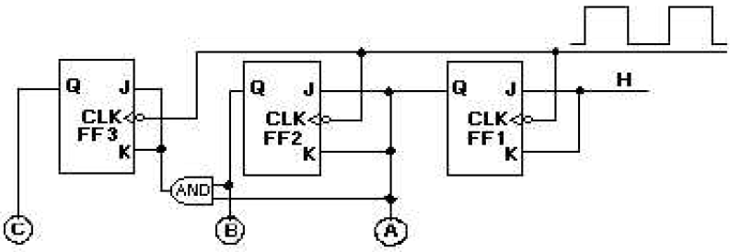
Modulus-8 Synch Counter
High-frequency operations require that all the flip-flops of a counter be triggered at the same time to prevent errors. We use a SYNCHRONOUS counter for this type of operation.
The synchronous counter is similar to a ripple counter with two exceptions: The clock pulses are applied to each FF, and additional gates are added to ensure that the flip-flops toggle in the proper sequence.
A logic diagram of a three-state (modulo-8) synchronous counter is shown below. The clock input is wired to each of the flip-flops to prevent possible errors in the count.

Slide 7
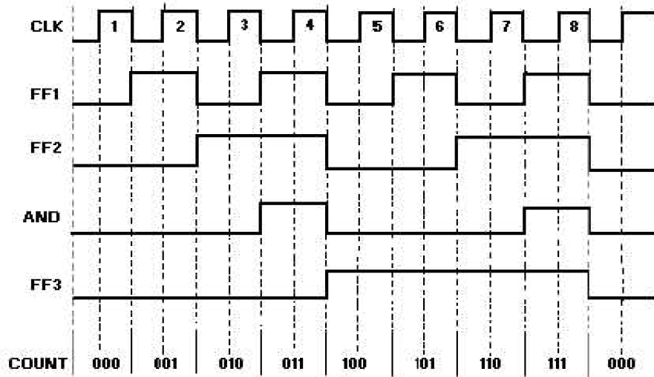
Modulus-8 Synch Counter Design

Slide 8
Thanks
&
Any query ?

